Slide 1
Implement the SDR representation in the MAUI application
Presented By, Submitted to,
Name: Mehe Zabin Trisha Damir Dobric / Andreas Pech
Matriculation No.: 1400382 Program: M.eng. Information technology
Name: Kazi Md. Abu Mithfa Module: Software Engineering
Matriculation No.: 1429088 Frankfurt university of applied sciences
Name: Saleque ahmed
Matriculation No.: 1393172

Slide 2
Overview of the Presentation
Abstract
Introduction
Features of the MAUI application
Outputs
Conclusion
Future Work

Slide 3
Abstract
Addressing the need for user-friendly interfaces in software engineering, our project details the creation and deployment of a Multimodal Adaptive User Interface (MAUI) application. Focused on Sparse Distributed Representations (SDRs) visualization using Scalable Vector Graphics (SVG), our app seamlessly transitions SDR representations from Python scripts to an interactive MAUI app in C#. By accepting various input formats and utilizing SVG features for layout customization, our app enhances user experience. Additionally, a download feature enables users to save generated outputs. Our work contributes to advancing SDR methodologies and MAUI app development in software engineering.

Slide 4
Introduction
Sparse Distributed Representation is a frequently employed idea in neural network frameworks, especially within unsupervised learning and spatial coding. It involves representing data in a high-dimensional space where only a small fraction of dimensions is given at any time. This representation is valuable for tasks such as pattern recognition, anomaly detection, and memory storage, among others.
In the ever-evolving landscape of software engineering, the emergence of Multimodal Adaptive User Interface (MAUI) applications represents a pivotal advancement. MAUI applications offer unparalleled versatility and adaptability, catering to the diverse needs of modern users. By seamlessly integrating various input formats and leveraging advanced features such as Scalable Vector Graphics (SVG), MAUI applications transcend traditional boundaries, facilitating enhanced user experiences across platforms. This presentation explores the transformative capabilities of MAUI applications, highlighting their potential to revolutionize software development and redefine user interactions in the digital age.

Slide 5
Features of the MAUI application

Slide 6
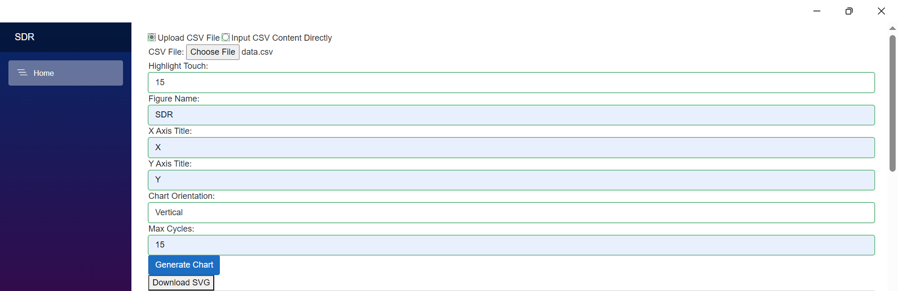
Giving Input as file
The user can give the input file from his local device by clicking “Choose File” option to generate the SDR graph.
In addition, he/she must give all the input values.
Otherwise, the graph will not generate.
Fig: Giving Input as a file[1]

Slide 7

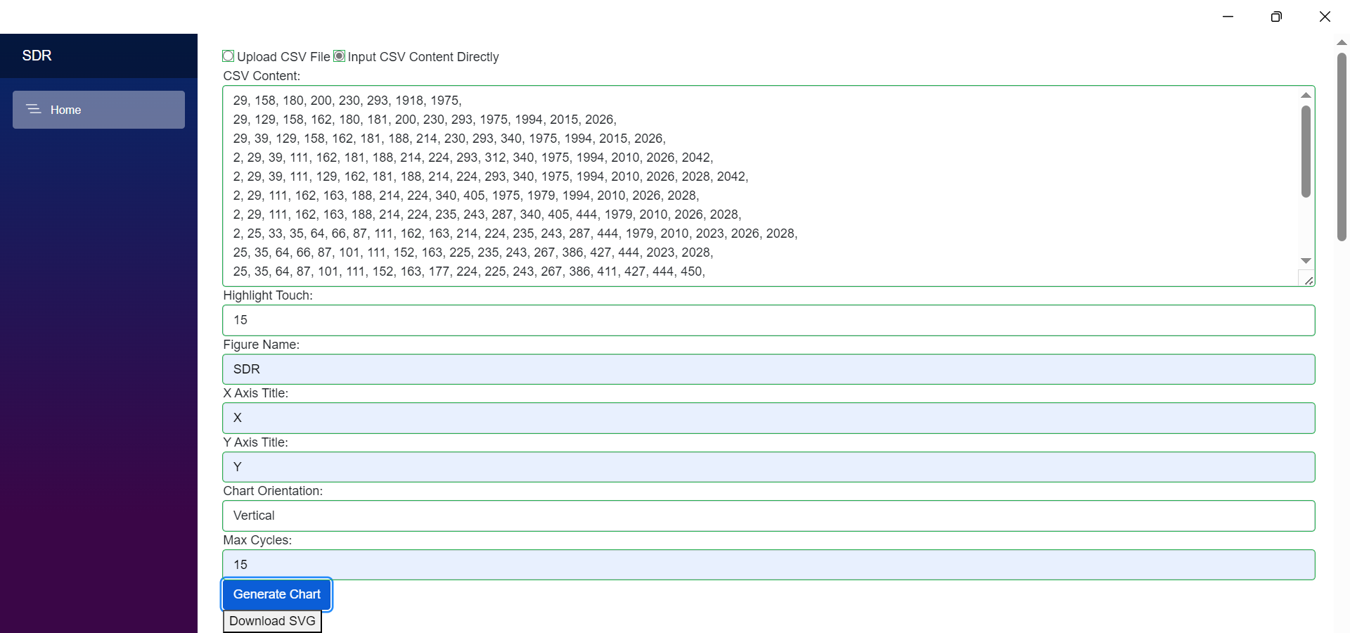
Giving Input data as Text file
User can give input data manually into the text field by selecting “Input CSV Content Directly” to generate the SDR chart.
Here he/she can paste the input data.
User must give other inputs.
Fig: Input data as text file[2].

Slide 8
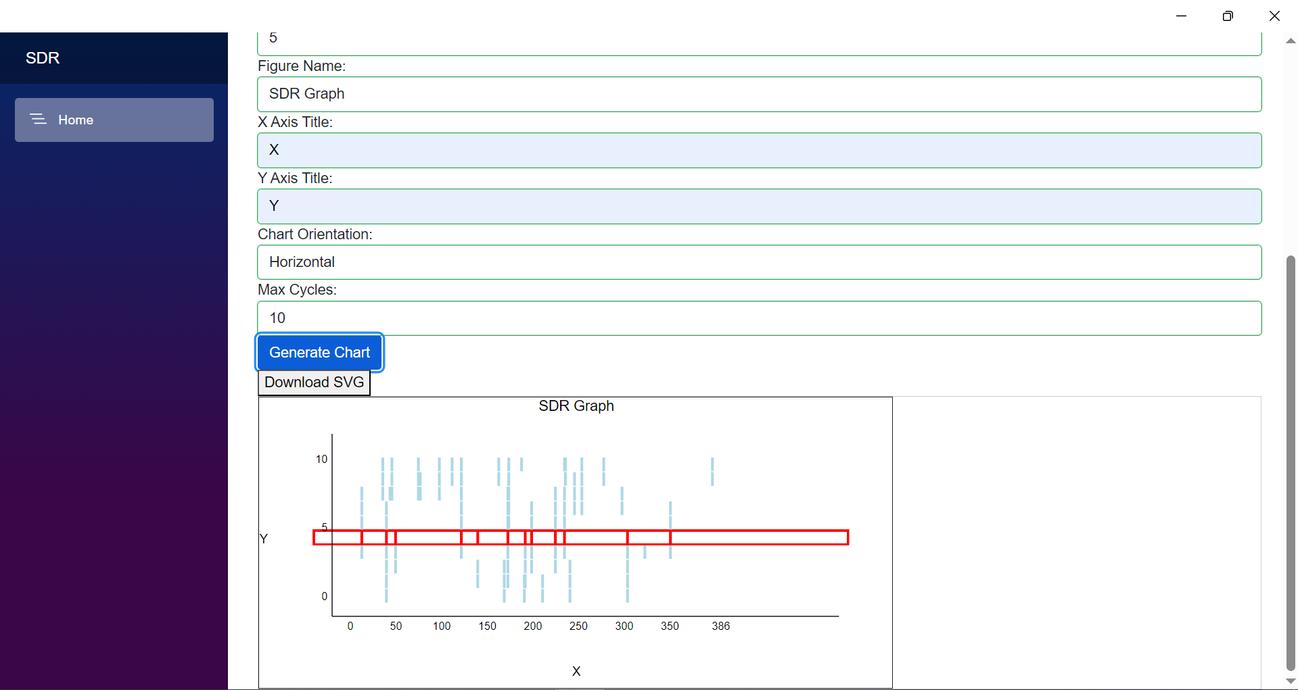
Horizontal output
This is the Horizontal Output of the SDR.
Fig: Horizontal Output[3].

Slide 9
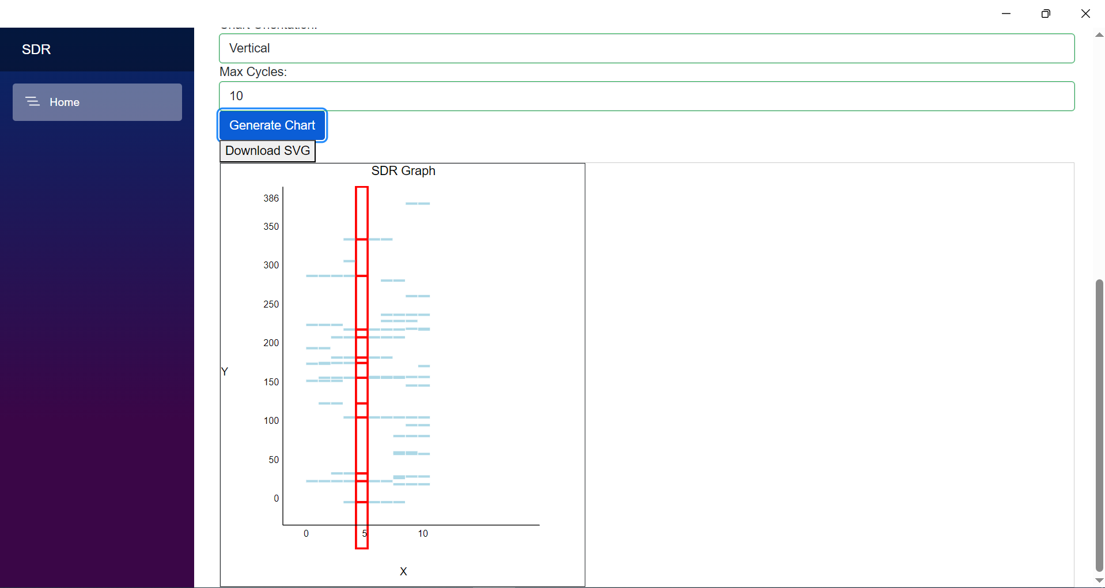
Vertical Output
This the generated Vertical output of SDR.
Fig: Vertical Output[4].

Slide 10
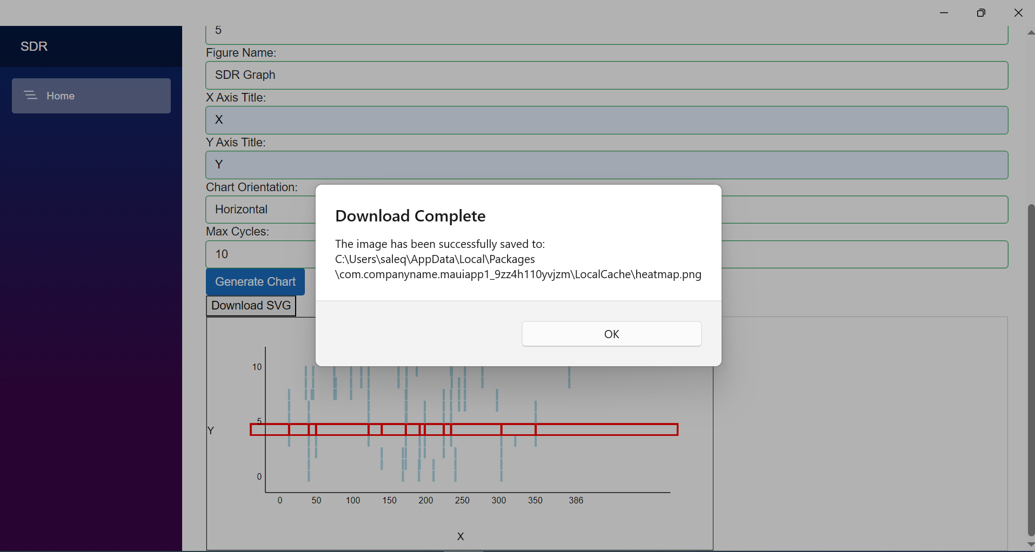
Downloading the Image
Using this feature user can download the generated SDR graph.
It will be saved automatically in the given path.
Fig: Downloading the image[5].

Slide 11
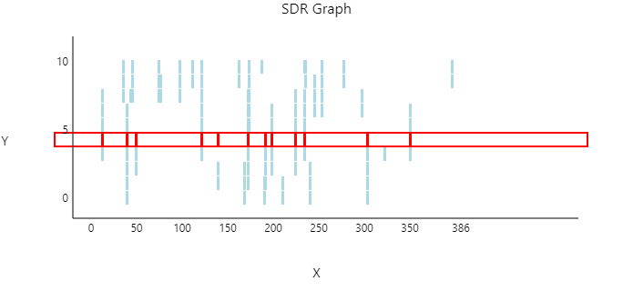
Preview of the downloaded Image
This is the downloaded image which was generated after downloading the image.
It will be downloaded in png format.
Fig: Downloaded image[6].

Slide 12
Conclusion
Our study highlights the successful development of a MAUI application in C# for representing Sparse Distributed Representations (SDRs) both horizontally and vertically, meeting the requirements set by our professor. Through this endeavour, we've effectively bridged theoretical concepts with practical application in user interface design and software development, showcasing the versatility and efficiency of C# and MAUI in visualizing complex data structures.

Slide 13
Future Work
Our study acknowledges certain limitations, primarily our focus on meeting course requirements, which may have constrained our exploration and innovation. Moving forward, future research should focus on optimizing MAUI application performance for SDR representations, integrating advanced features such as signal processing algorithms, and extending compatibility to broader platforms. These endeavours promise to advance the capabilities of MAUI applications and further contribute to the evolving landscape of software development.

Slide 14






